Slide 1
Group-Based Offending Data

Slide 2
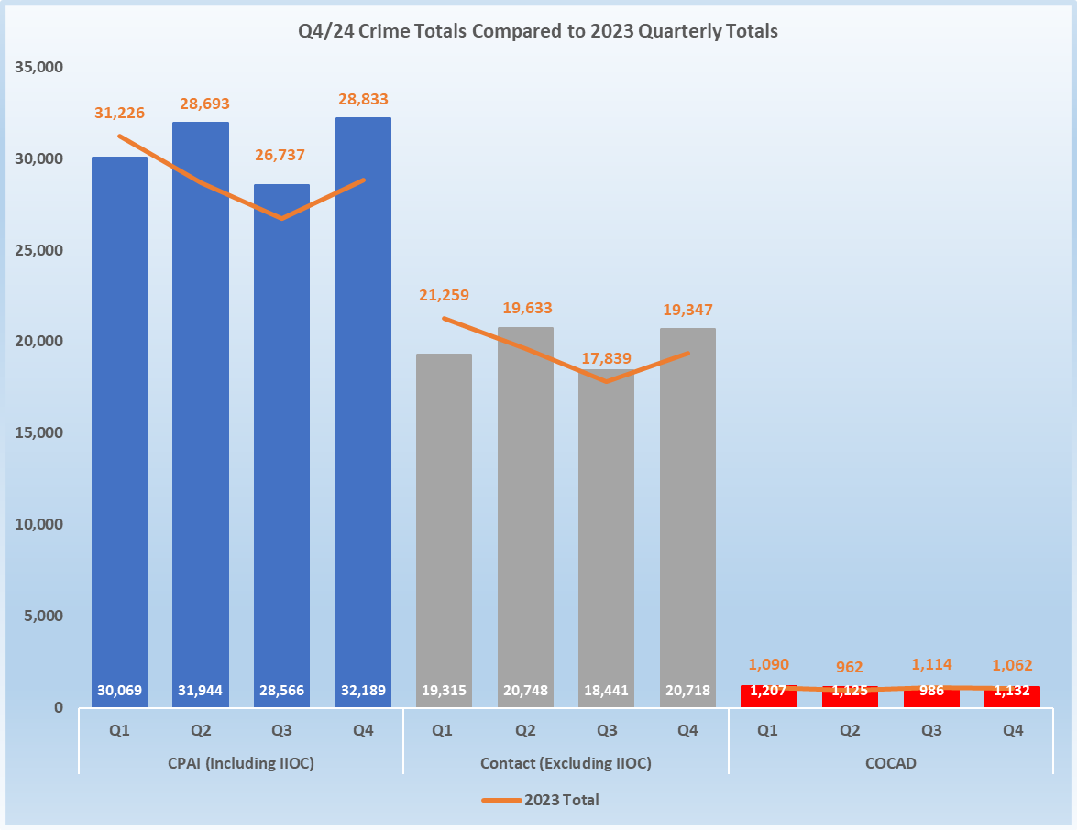
SCALE - Child Sexual Abuse and Exploitation Crimes and those identified as group-based
“CPAI” (BLUE BARS) refers to the dataset of all CSA crimes and those CSA crimes flagged as CSE (including IIOC). “Contact” (GREY BARS) represents the number of contact only crimes within the CPAI dataset. “COCAD” (red bars) shows the total number of “group based” crimes within the total number that were “contact.”
COCAD offences are qualitatively read and categorised into the criteria represented on slide 3 ; CSE, familial, institutional, ritualised, child on child, other and unknown.
Due to rounding up and down of percentages, some data within this report may not add up to exactly 100%.

Slide 3
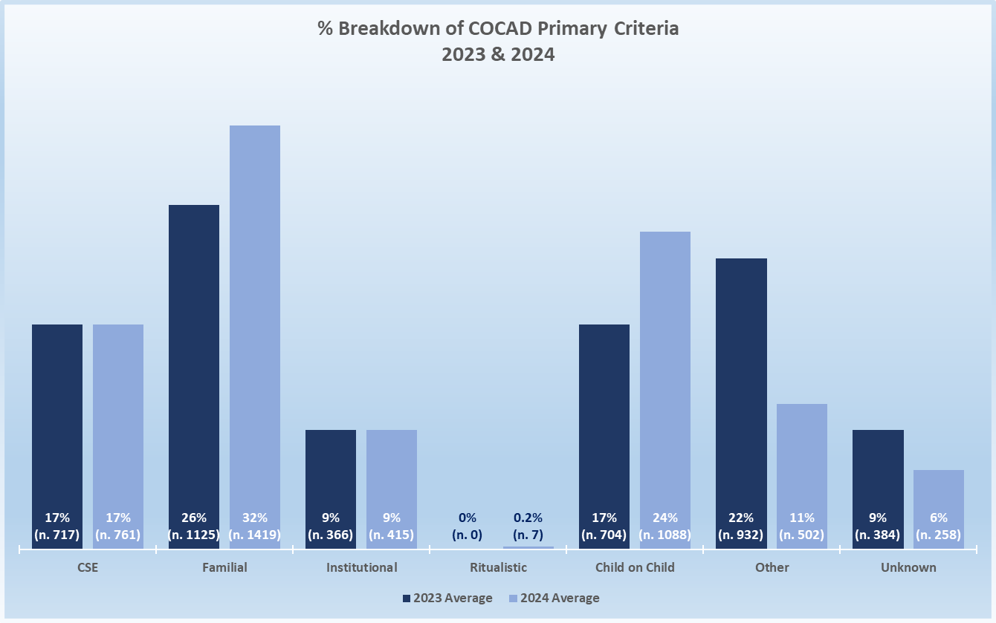
SCALE – Group-Based COCAD Criteria Breakdown
Increase noted in the percentage of familial and child on child crimes, however, child on child not recorded in Q1 2023 which explains why the 2023 percentage is lower.
The percentage of CSE and institutional crimes has remained consistent through 2023 and 2024.
Dark blue = 2023 Light blue = 2024
“Other” – this category contains all crimes that are not assessed as CSE, familial, institutional, ritualistic or child on child.
“Unknown” – this category contains all crimes that provide insufficient information to assess criteria however the crime does indicate a group-based element
Due to rounding up and down of percentages, some data within this report may not add up to exactly 100%.

Slide 4
How police record ethnicity data
SDE (Self-Defined Ethnicity) – This is when a person tells the police their own ethnicity.
ODE (Officer-Defined Ethnicity) – This is when a police officer records a person’s ethnicity based on how they look.

Slide 5
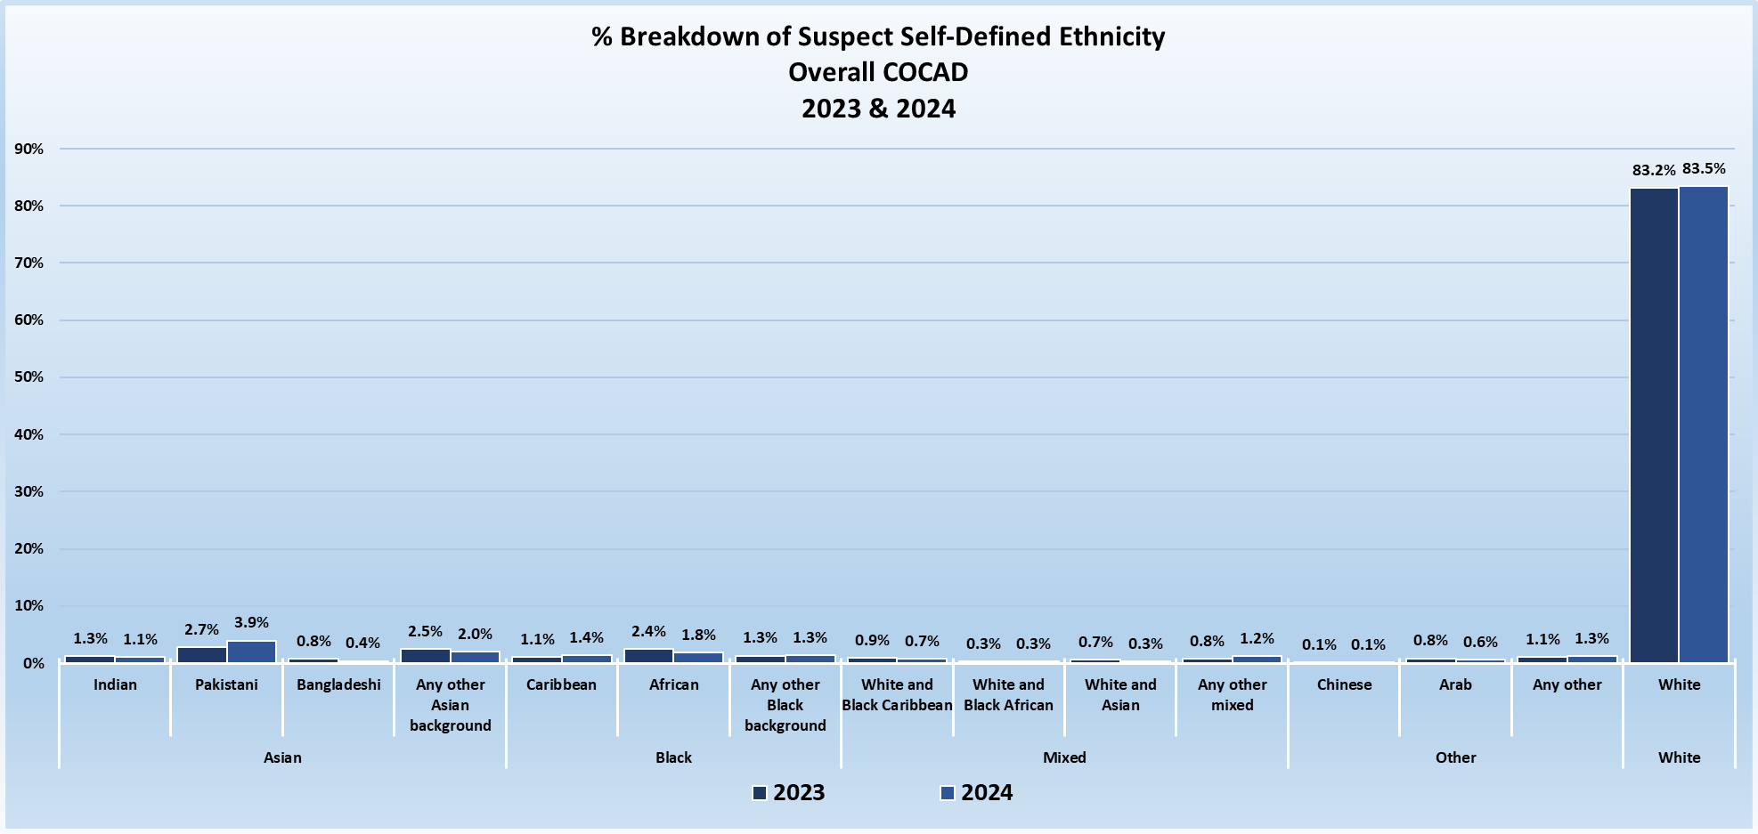
SDE Suspects across COCAD Grp Based OVERALL 2023 / 2024
NOTE: All Data on the slide is based on data extracted every 12 weeks, and as it stands at that time. In 2023 only 34% of suspect SDE data was available at the time of extraction and in 2024 this is 37%.
Due to rounding up and down of percentages, some data within this report may not add up to exactly 100%.

Slide 6
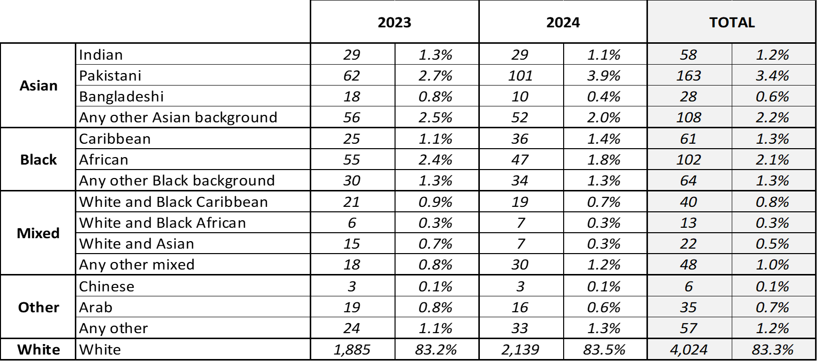
SDE Suspects across COCAD Group Based OVERALL 2023 / 2024
NOTE: All Data on the slide is based on data extracted every 12 weeks, and as it stands at that time. In 2023 only 34% of suspect SDE data was available at the time of extraction and in 2024 this is 37%.
Due to rounding up and down of percentages, some data within this report may not add up to exactly 100%.

Slide 7
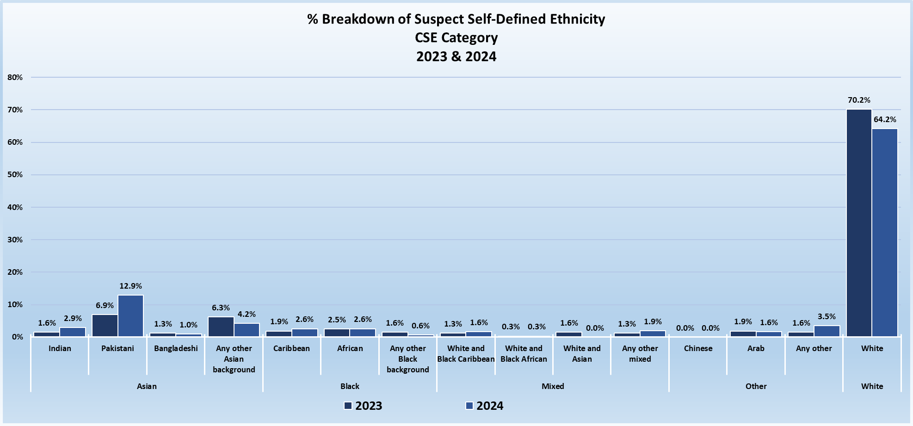
SDE Suspects across COCAD Group Based CSE Category 2023 / 2024
NOTE: All Data on the slide is based on data extracted every 12 weeks, and as it stands at that time. In 2023 only 34% of suspect SDE data was available at the time of extraction and in 2024 this is 37%.
Due to rounding up and down of percentages, some data within this report may not add up to exactly 100%.

Slide 8
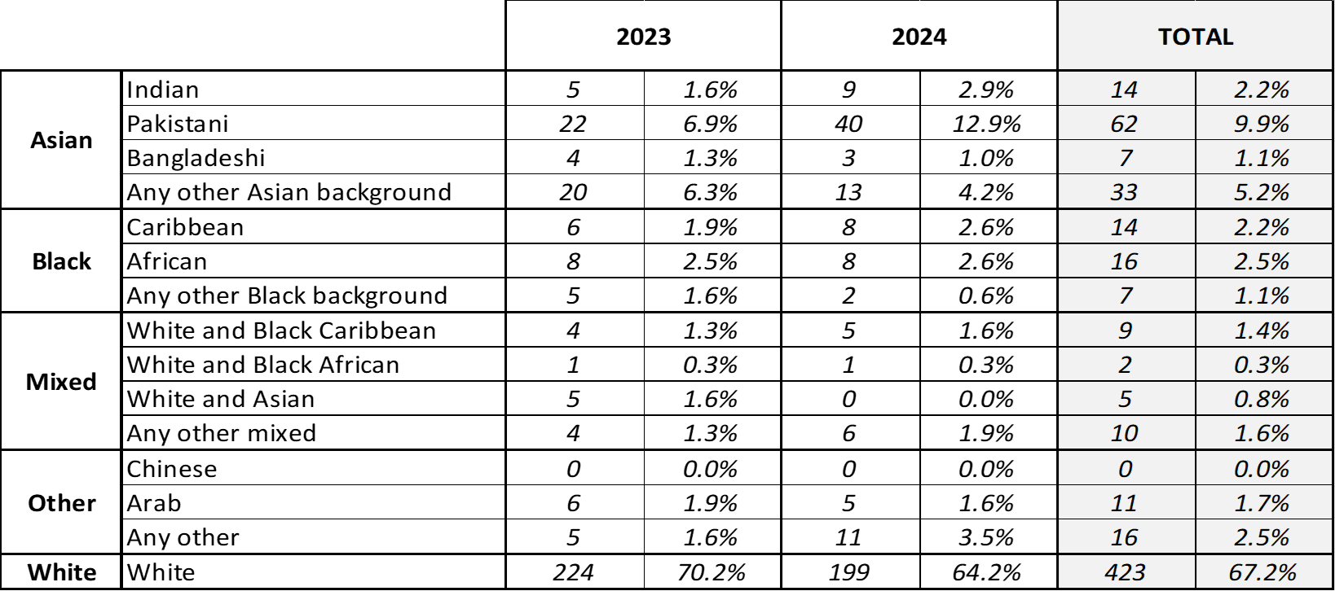
SDE Suspects across COCAD Group Based OVERALL 2023 / 2024
NOTE: All Data on the slide is based on data extracted every 12 weeks, and as it stands at that time. In 2023 only 34% of suspect SDE data was available at the time of extraction and in 2024 this is 37%.
Due to rounding up and down of percentages, some data within this report may not add up to exactly 100%.

Slide 9
Group-based offending data

