Slide 1

Operation Makesafe
Hotels and Accommodation
April 2026

Slide 2
Learning Objectives
To understand what Operation Makesafe is and how it relates
to you.
To learn about child exploitation.
To recognise your responsibilities around safeguarding within the workplace.
To identify the children who could beat risk.
To feel confident in taking action and knowing how to report your concerns.

Slide 3




What is Operation Makesafe
Police forces working with hotels since 2011 to raise awareness of CSE with staff and businesses to increase reporting.
Approach includes delivery of training to hotels as well as test purchase operations to check levels of staff awareness.
Significant local variation in operational approach to Makesafe.
CSE Taskforce adopted the national ownership of Makesafe in December 2023.

Slide 4
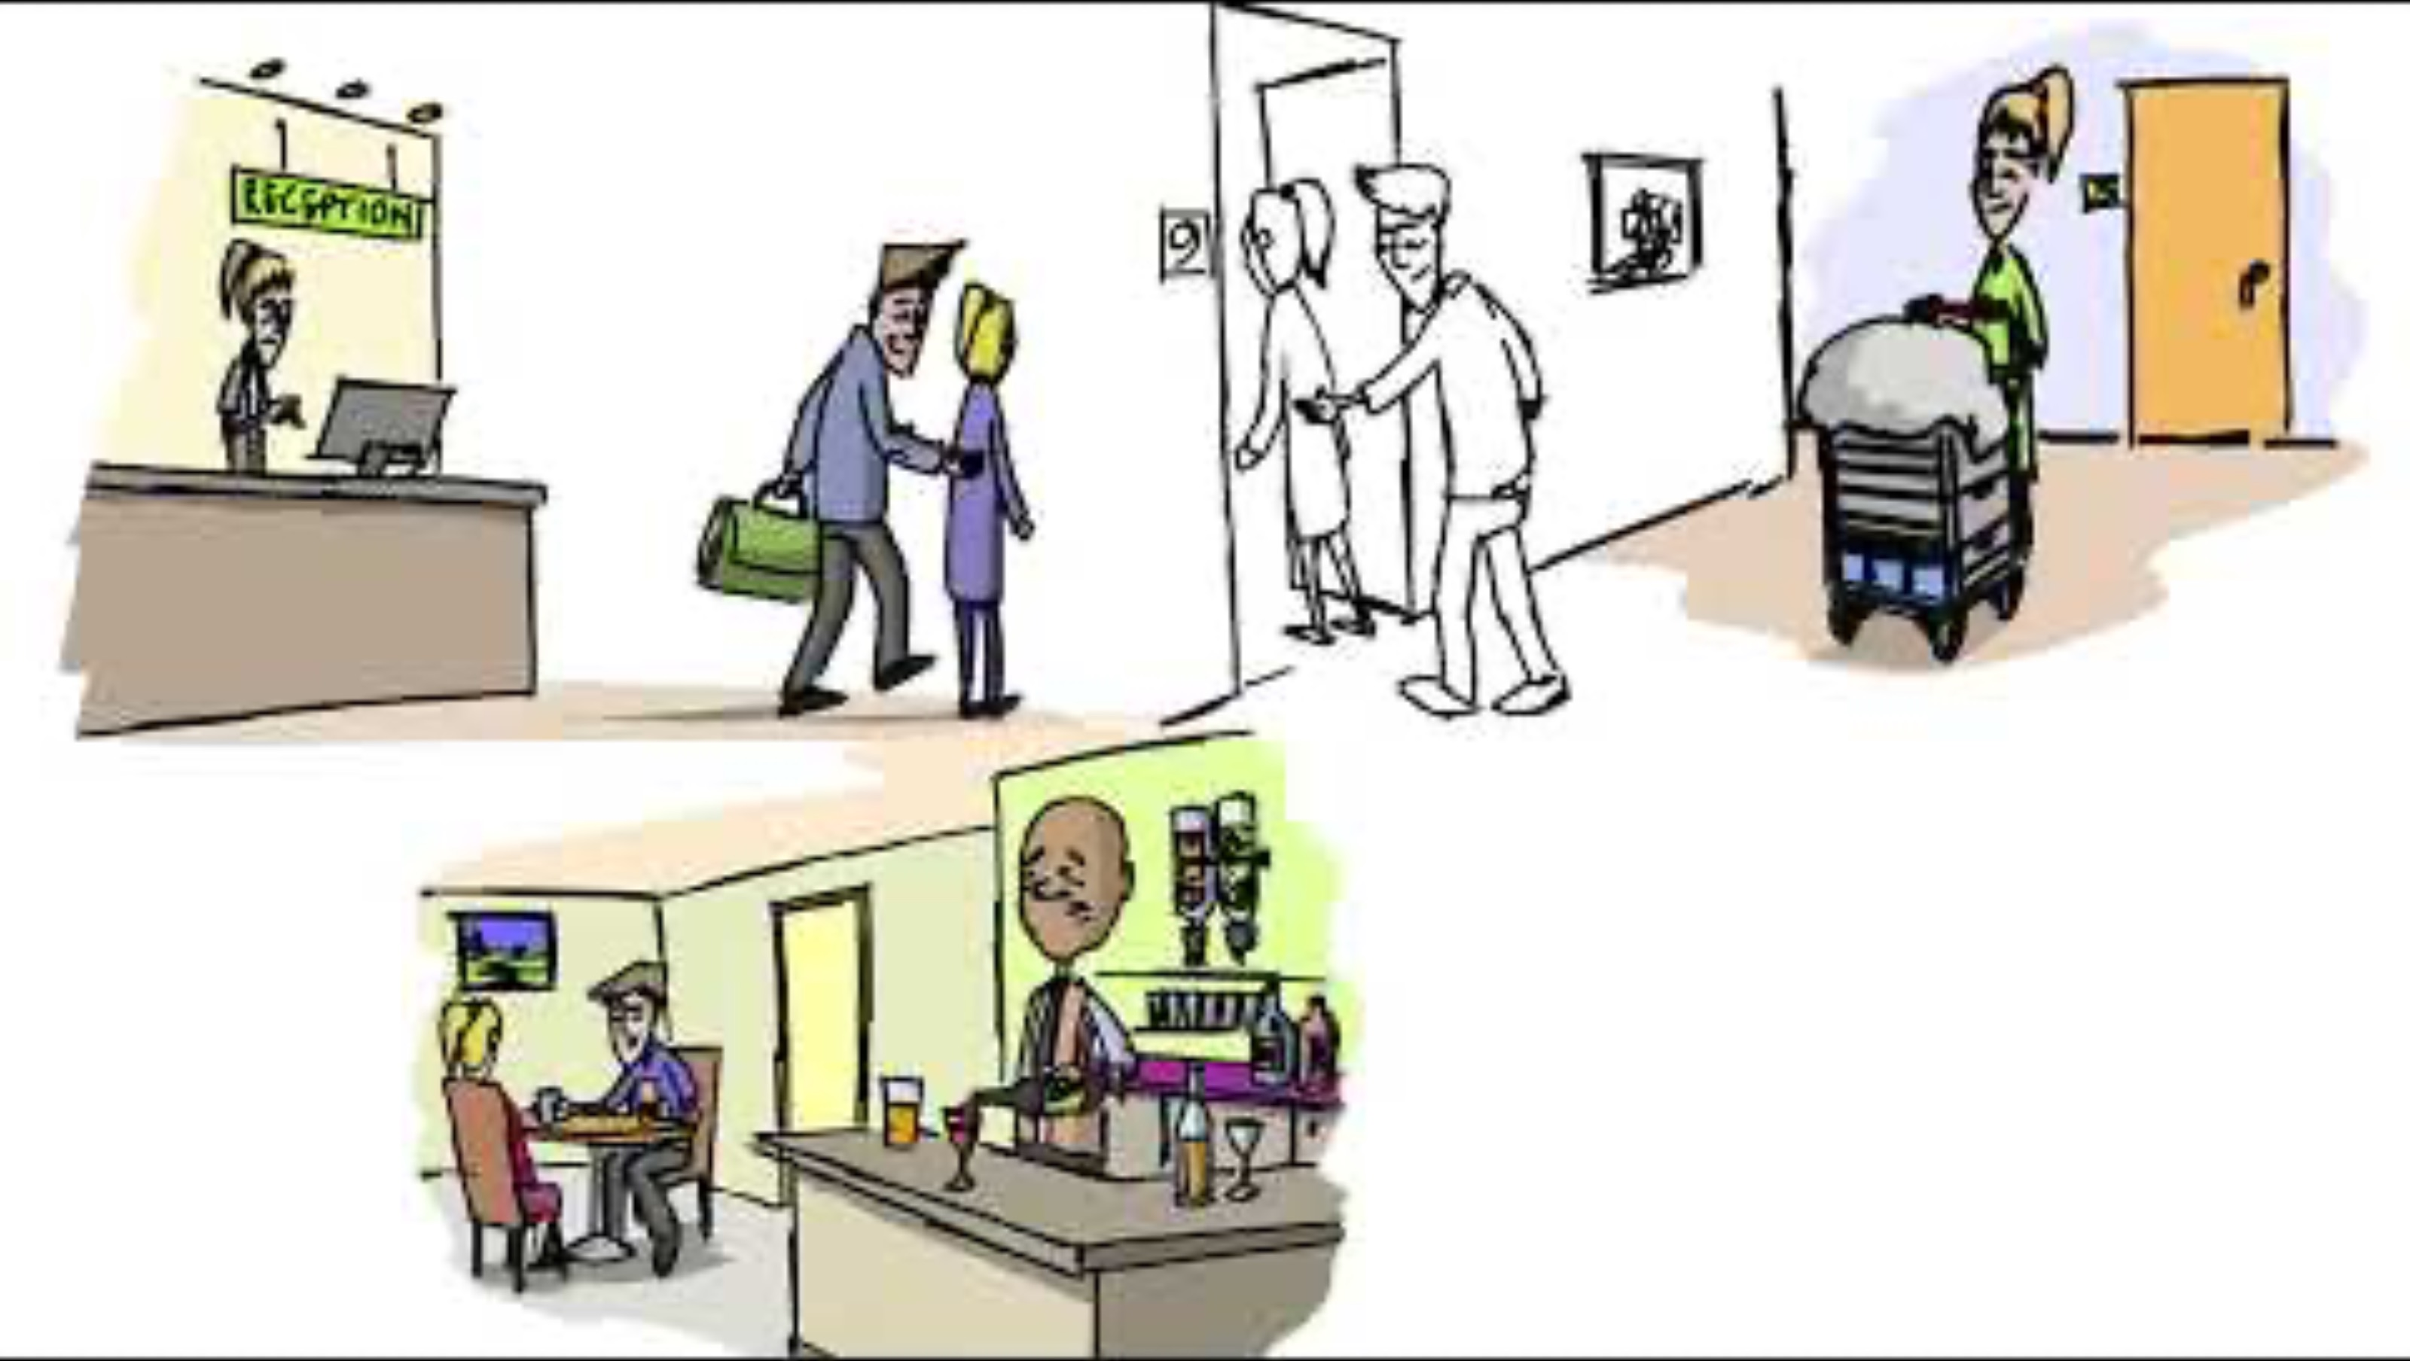
Operation Makesafe Animation

Slide 5

Why Makesafe Important
Privacy of hotel room emboldens offenders to commit rape and serious sexual assaults of children.
Over 500 child sexual abuse crimes recorded in a year took place in hotels.
Makesafe provides an opportunity to prevent and disrupt abuse and exploitation and safeguard children.
HMICFRS cites Makesafe as an essential component of force work to disrupt CSE.

Slide 6






The Scale and Nature of the Problem
Offenders target budget hotels in close proximity of public transport hubs and other amenities.
Victim profile involves older children than the average age of victims in broader CSAE dataset.
Offenders are primarily young men in their 20s and 30s, in some cases only a few years older than victim.
Offenders prepared to travel significant distances to meet with children who are trafficked via public transport network.
Online contact prior to in person meetings was prevalent.
It is highly likely perpetrators will sexually communicate and build trust of the victim before instigating a meet at a hotel.

Slide 7
What is Child Sexual Exploitation
“Child sexual exploitation is a form of child sexual abuse. It occurs where an individual or group takes advantage of an imbalance of power to coerce, manipulate or deceive a child or young person under the age of 18 into sexual activity in exchange for:
(a) Something the victim needs or wants
and/or
(b) For the financial advantage or increased status of the perpetrator or facilitator.
The victim may have been sexually exploited even if the sexual activity appears consensual. Child sexual exploitation does not always involve physical contact; it can also occur through the use of technology.”

Slide 8
” On the way out of the hotel, the man on the desk looked at me ……. I felt that he knew something was wrong …….. but he looked away …….. they always look away ………… it’s weird because there must be something they can do …….. Right?”
Testimony – 13-year-old victim

Slide 9
Indicators of Child Exploitation
Guests arriving and asking for a specific room number, but they don’t know the name in which the room is booked. | Guests requesting a room that is isolated, or near the rear exit of the premises, fire exits or car park entrances. | Guests only using the room for a few hours despite booking for one night or the use of hourly hotel rooms. | Guests refusing to provide identification or card details or insisting on paying in cash. | Children or young people who seem withdrawn, highly anxious or scared.
Young people meeting others in the hotel’s public areas eg. Bar or car park. | Bookings made in a different name to the person checking in without a valid reason. | Young people suspected to be under the influence of alcohol or drugs. | Guests or visitors who appear secretive about who they are with. | Guests arriving with large amounts of alcohol on their person.
Young people booking a taxi via reception. | Guests having little or no luggage. | Multiple visitors to a room. | Last minute or walk-in bookings. | Noise complaints.

Slide 10










What to look for
A pre-paid bar tab to a room where children stay.
Guests who don’t want their room cleaned or visited.
Guests who access an excessive amount of pornography.
Guest rooms with a lot of condoms / condom wrappers.
Signs of alcohol, drug or substance misuse.
Lots of coming and going from the room / noise complaints.
Lots of cars / taxis associated to 1 or 2 rooms.
Guests arriving and asking for a specific room number but not knowing the name in which it was booked.
Young people with significantly older partners.
A young person who appears withdrawn or appears afraid, disorientated or acting under instruction.

Slide 11
Scenario 1
One of the cleaners has reported finding empty alcohol bottles, Condom wrappers, and signs of recreational drug use in a room. When asked about anything suspicious, one of the security guards mentions that a guest brought a number of people in and out of the hotel overnight - a range of ages.
There were several noise complaints from the room during the night. When the guest was challenged by staff, they became abusive and un-cooperative.
?
What in this situation makes you feel concerned

Slide 12
Scenario 2
A room has been booked over the phone, and when it comes time to check in the person checking in appears to be quite a young teenage boy. His clothes smell very strongly of cannabis, but he doesn’t seem to be high - he looks tired and scruffy.
He goes to the room, and over the next several hours, a lot of unknown adults come in and go straight up to his room without stopping at reception - however they don’t stay long.
?
What in this situation makes you feel concerned

Slide 13
Scenario 3
An adult comes in with a teenage girl. He books a twin room. The girl is talking to the man and you can tell from her speech that she has a learning need of some kind. When you ask her what she’s doing in the city, she goes to answer, but the adult cuts her off and answers for her. He does this on several occasions as you try to make conversation with the young person.
In the evening, the adult goes out, while the girl remains in the room. He comes and goes several times over the evening accompanied by different adults.
?
Is there anything in this situation that makes you feel concerned

Slide 14
What to do if you suspect Child Exploitation is taking place
Call the police on 101 or 999 in an emergency – if you are concerned a child is in the company of someone wishing to harm them you must always call 999.
You can also report to the police online. Only report your concerns when it is safe for you to do so, even if this is after the event that your concerns initially arose.
Contact your Neighbourhood Policing Team or Licensing Officer for further support.
Call Crimestoppers on 0800 555 111. If you have information on child exploitation
and abuse or suspect it may be happening but want to remain completely anonymous, you can contact the independent charity Crimestoppers online or on the phone.
Call the NSPCC on 0808 800 5000. The NSPCC helpline is staffed by trained
professionals who can provide expert advice and support if you’re concerned about a child.

Slide 15
What information you should provide to the police
What is the exact current location of the suspects and victim? (i.e. hotel room number, street address, drop off place, area of bar etc)
Concise description of both the suspect and victim?
If known, names and D.O.B of both suspect and victim?
Any vehicles involved, if so colour, make, model and VRM?
Who is the designated member of staff meeting police and where will they meet police?
What are the specific reasons for concern?
If suitable you will receive scene preservation advice
When a call is made to police, quoting ‘Operation Makesafe’, a trained police call handler will ask a series of questions, which will determine the police response graded appropriately, based on information supplied

Slide 16
Thank you
Any Questions?

